Slide 1
DDS For Live Session
UNIT 1
Diane Roberts
1-8-2026
(Late due to not being admitted to the course until 1/6/26. I was also not able to attend the first class so I will now watch it asynchronously.)

Slide 2
Philosophy Due at 1pm CST the day of live session.
On the next slide you will see activities and the estimated / expected time that the student should spend on that activity.
It is important to note that the goal of the activities is to become familiar with the methods, ideas and implementation involved in that activity so that we can efficiently iron out all the details in live session.
Analogy: You are building the pieces of puzzle in the For Live Session Activity and we are putting them together to see the big picture in live session.
It is not expected that the student have all the correct answers. The expectation is that each student spend the allotted time (indicated next to the activity) on each activity so that we can discuss the details in live session.
If you max out the indicated time without finishing the activity and you don’t have more time to finish, simply write up what you have learned by that time and record any questions you might have and we will address those in live session!
We want to develop the questions before live session so that we can use the live session time to effectively answer them!

Slide 3
For Live Session: Unit 1 Due at 1pm CST the day of live session.
For each number, provide at least 1 PowerPoint slide to provide a clear presentation of your response. You will present most of these slides in a break out and are given a score based on their completeness and clarity. Most importantly, they will maximize your live session experience!
Data Science Profile: Make a bar plot for your data science profile. (1-2 hours) The Data Science Profile is described in the Cathy O’Neil reading for Unit 1 from Doing Data Science.
CLT: Using the central limit code from the asynch material (CLT2.Rmd), adapt the code and provide the following analysis: (2-3 hours)
Adapt the code to generate a population of 10,000,000 from a chi-square distribution with 2 degrees of freedom. This is a heavily right skewed distribution. (Hint: rchisq()). You will have to read up on this function and probably do some trial and error. Being able to learn new functions and methods is a key skill.
Provide a histogram of this population… display the right skewness.
Record the mean and standard deviation of this population.
According to the central limit theorem, what should be the approximate distribution of sample means of size 50 from this right skewed population? What should be the mean and standard error of the mean (standard deviation of the distribution of sample means)?
Now let’s check this: Adapt the CLT code to draw 10,000 means each of size 50 from this population and provide the sampling distribution of this sample mean. Provide a histogram of these 10,000 sample means.
What is the mean and standard deviation of these 10,000 sample means?
Ask ChatGPT (you pick the version) to try and address the previous question.
T-Test (2-3 hours)
Research in R how to conduct a T-test (t.test) and conduct a six step hypothesis test to answer the question on the next slide. If you would like to brush up on hypothesis tests, please see the Bridge Course for Statistics.
Takeaways and/or Questions: What were your key – takeaways from from this unit and what were any question or comments you would like to make? Your professor will use these to customize live session.
(1 hour)

Slide 4
1. Data Science Profile
Self-Assessment Methodology:
• Evaluation Type: Relative scale for self-reporting strengths.
• Scale Range: 1 (No Skills) to 10 (Expert/Independent Execution).
• Mid-Point (5): Average proficiency; possesses broad skills but may
require guidance for individual execution.
• Scope: Covers Computer Science, Math, Statistics, Machine Learning,
Domain Expertise, Communication, and
Data Visualization.
Each category assumes 2-3 parameters for validation (e.g. Computer Science: can code in R, Python, SQL…)
My self-assessed data science profile (certainly subjective) shows that I feel that my math and stats skills need continual refinement.
Notes:
Using a relative scale for self-reporting, I evaluated my strengths in each of the 7 domains: Computer Science, Math, Statistics, Machine Learning, Domain Expertise, Communication and Presentation Skills and Data Visualization. I used a scale for visual purposes of 1-10. 1 = no skills, 5 = Average. May have some of the broad skills listed below but don’t feel confident executing individually, 10 = expert, don’t require much guidance and think of myself as someone who can execute without guidance.
Computer Science: Use R and SQL, knowledge of Python, data structure and algorithms, have used Git before for source code control and versioning and proficient in governance for best practices with software engineering. = 7
Math: Strong comfort level with math but will need to brush up based on length of time away from attaching mathematic formulas to day-to-day work = 6
Statistics: Strong comfort level with statistics and will need to continue to brush up on calculations and use of SAS = 6
Machine Learning: Very strong knowledge of supervised and unsupervised learning algorithms. Current work does not explicitly reference traditional classification metrics but focuses closest on accuracy and precision-recall. Answer-quality (% of answers that meet acceptance criteria) is closest to Accuracy and Precision-Recall. = 7
Domain: Very strong knowledge of industry challenges in the evaluation of data particularly in the Finance and Sustainable Agriculture domains. There is an incredible amount of data, an insatiable appetite for more data but industries continue to struggle with producing the right data to determine how to align with desired business outcomes. = 9
Communication and Presentation Skills: Expert at C level communications to use industry and leadership language. Rarely do I talk in terms of technology but focus more on the outcomes desired, how this can be done in a certain industry and why technology is an enabler for those outcomes. = 9
Data Visualization: Heavy use of Tableau and Tableau Next tools. = 8

Slide 5
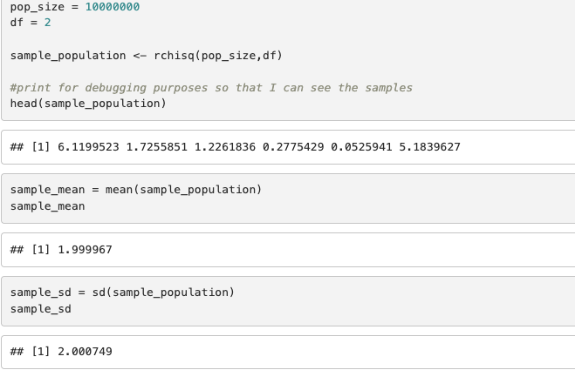
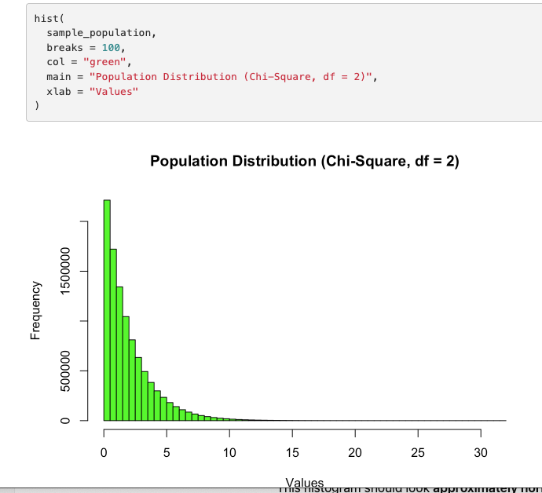
2. CLT code modification
1 & 3. Population = 10,000,000, df = 2; df indicates a right skewed population; standard deviation and means
2. Draw a histogram of the population
Notes:
Modified CLT2.RMD code to reflect the creation of a population of 10,000,000 with a df = 2. I modified the code to do this but wanted to understand why using this function was recommended. As part of the Central Learning Theorem (hence CLT), CLT – repeatedly taking random samples from any population and computing the sample mean each time, then the distribution of those sample means will become approximately normal (bell-shaped) as the same size increases. I understand why the degrees of freedom impact the skewing but am still exploring why this function was used to obtain the sample-population data. By choosing a population size of 10,000,000 rchisq() illustrates how the data skews normal. It’s really the degrees of freedom that define the fact that this data is normal. The population mean is ~ 1.999062 (2 rounded). The population standard deviation ~ 1.999729.
The CLT says that for a sample size of 50 from the population then there will be a normal distribution around 2. The standard error is the standard deviation / square root of the sample size.
Therefore, it is 2/ square root (50). This is equal to 0.282989.

Slide 6
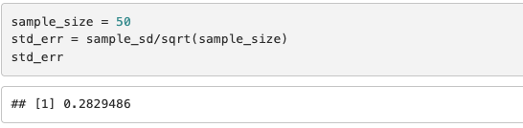
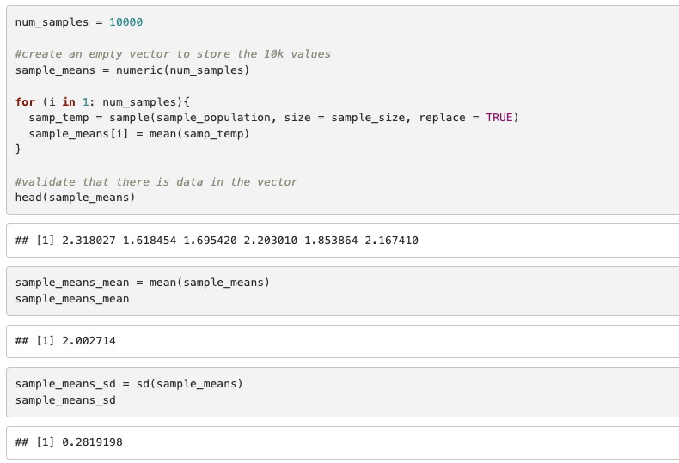
2. CLT code modification
4. According to the Central Limit theorem a sample size of 50 should be large enough to demonstrate a normal distribution around a mean of 2. The standard measure of error = .283
5 & 6. 10,000 samples of size 50, draw a histogram and provide the sample mean and sample standard deviation.
Notes:
Modified CLT2.RMD code to reflect the creation of a population of 10,000,000 with a df = 2. I modified the code to do this but wanted to understand why using this function was recommended. As part of the Central Learning Theorem (hence CLT), CLT – repeatedly taking random samples from any population and computing the sample mean each time, then the distribution of those sample means will become approximately normal (bell-shaped) as the same size increases. I understand why the degrees of freedom impact the skewing but am still exploring why this function was used to obtain the sample-population data. By choosing a population size of 10,000,000 rchisq() illustrates how the data skews normal. It’s really the degrees of freedom that define the fact that this data is normal. The population mean is ~ 1.999062 (2 rounded). The population standard deviation ~ 1.999729.
The CLT says that for a sample size of 50 from the population then there will be a normal distribution around 2. The standard error is the standard deviation / square root of the sample size.
Therefore, it is 2/ square root (50). This is equal to 0.282989.

Slide 7
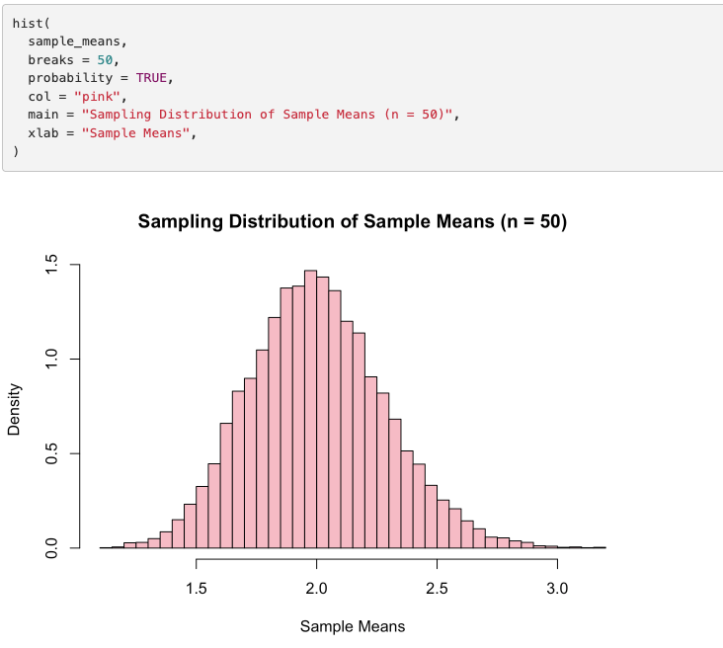
2. CLT code modification
5 & 6. 10,000 samples of size 50, draw a histogram and provide the sample mean and sample standard deviation.
Notes:
Modified CLT2.RMD code to reflect the creation of a population of 10,000,000 with a df = 2. I modified the code to do this but wanted to understand why using this function was recommended. As part of the Central Learning Theorem (hence CLT), CLT – repeatedly taking random samples from any population and computing the sample mean each time, then the distribution of those sample means will become approximately normal (bell-shaped) as the same size increases. I understand why the degrees of freedom impact the skewing but am still exploring why this function was used to obtain the sample-population data. By choosing a population size of 10,000,000 rchisq() illustrates how the data skews normal. It’s really the degrees of freedom that define the fact that this data is normal. The population mean is ~ 1.999062 (2 rounded). The population standard deviation ~ 1.999729.
The CLT says that for a sample size of 50 from the population then there will be a normal distribution around 2. The standard error is the standard deviation / square root of the sample size.
Therefore, it is 2/ square root (50). This is equal to 0.282989.

Slide 8
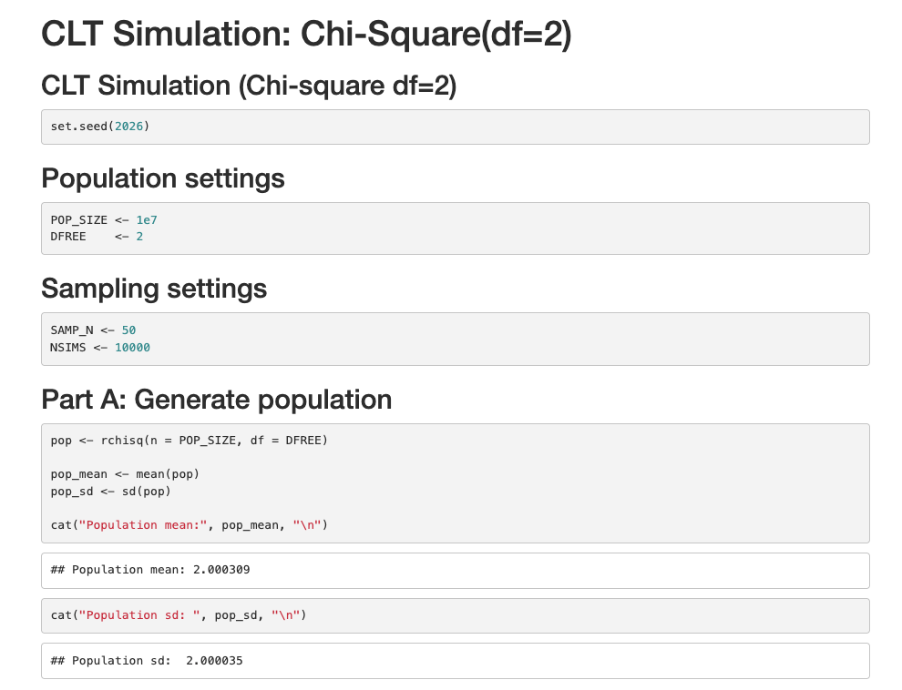
3. CLT code modification by ChatGPT 5.2
ChatGPT5.2 uses functions including a custom function to draw the histograms as well as a replicate() function to create the calculations and histograms.

Slide 9
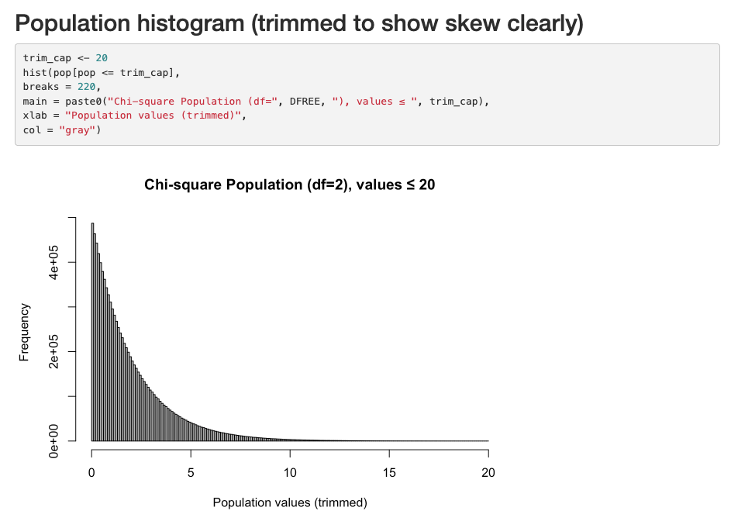
3. CLT code modification by ChatGPT 5.2
ChatGPT5.2 is cleaner with the depiction of the histogram trimming values shown for the population in the first histogram.

Slide 10
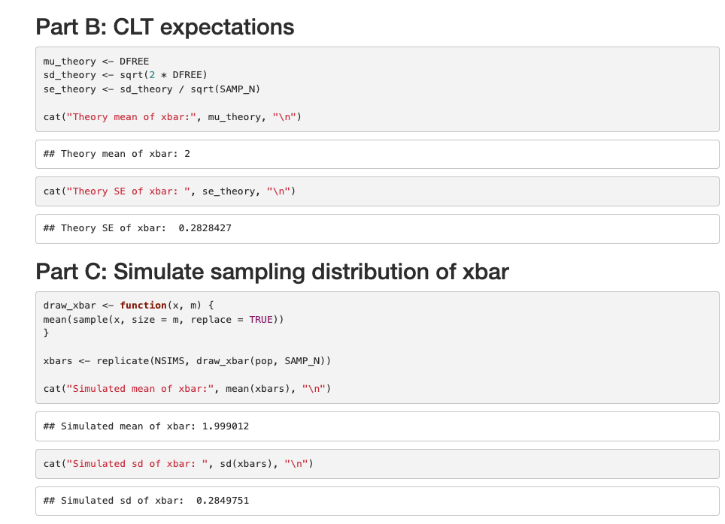
3. CLT code modification by ChatGPT 5.2

Slide 11
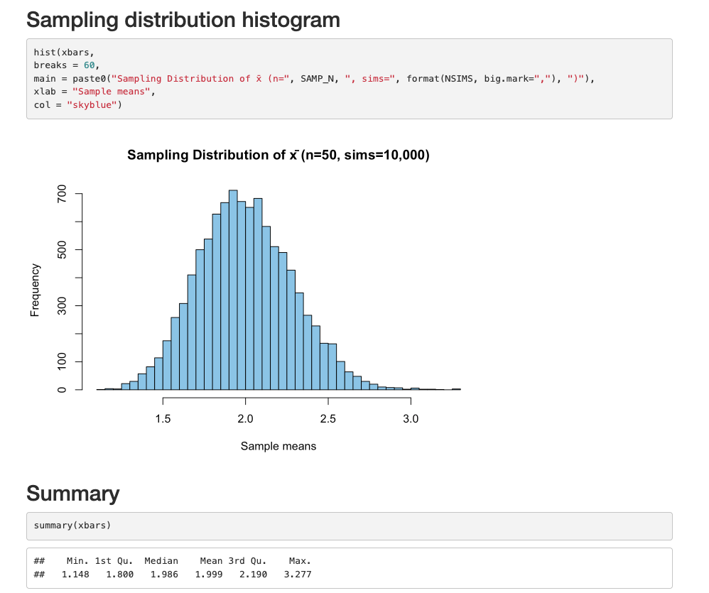
3. CLT code modification by ChatGPT 5.2

Slide 12
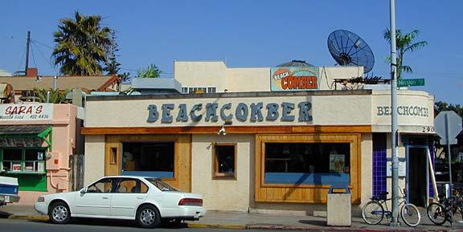
4 Hypothesis Test
The following are ages of 7 randomly chosen patrons seen leaving the Beach Comber in South Mission Beach at 7pm! We assume that the data come from a normal distribution and would like to test the claim that the mean age of the distribution of Comber patrons is different than 21. Conduct a 6 step hypothesis test to test this claim.
25, 19, 37, 29, 40, 28, 31

Slide 13
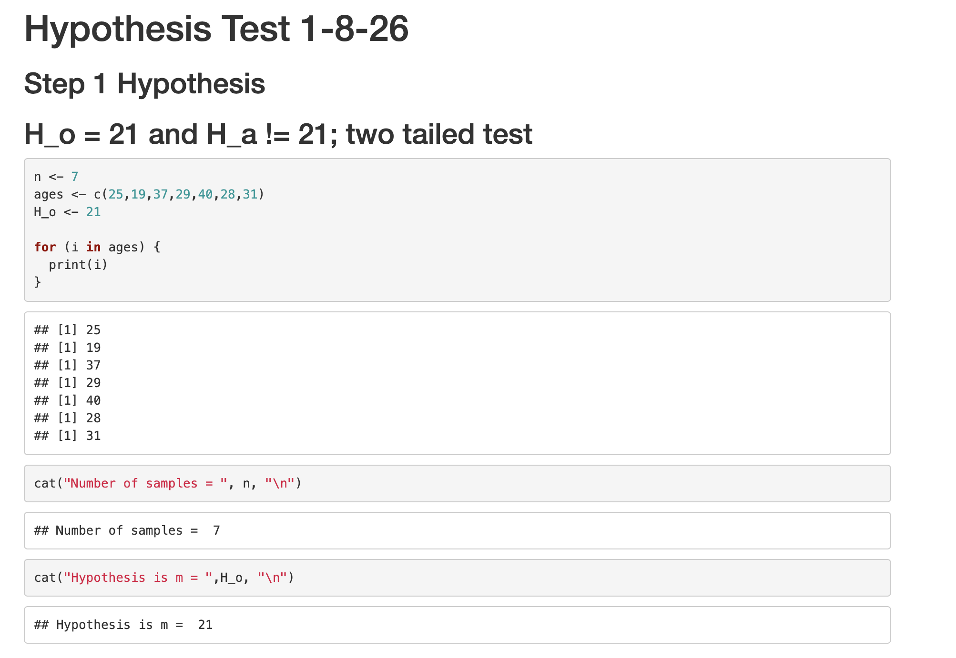
4 Hypothesis Test
6 step hypothesis t-test. H_o = 21. H_a != 21. This creates a two-tailed test.

Slide 14
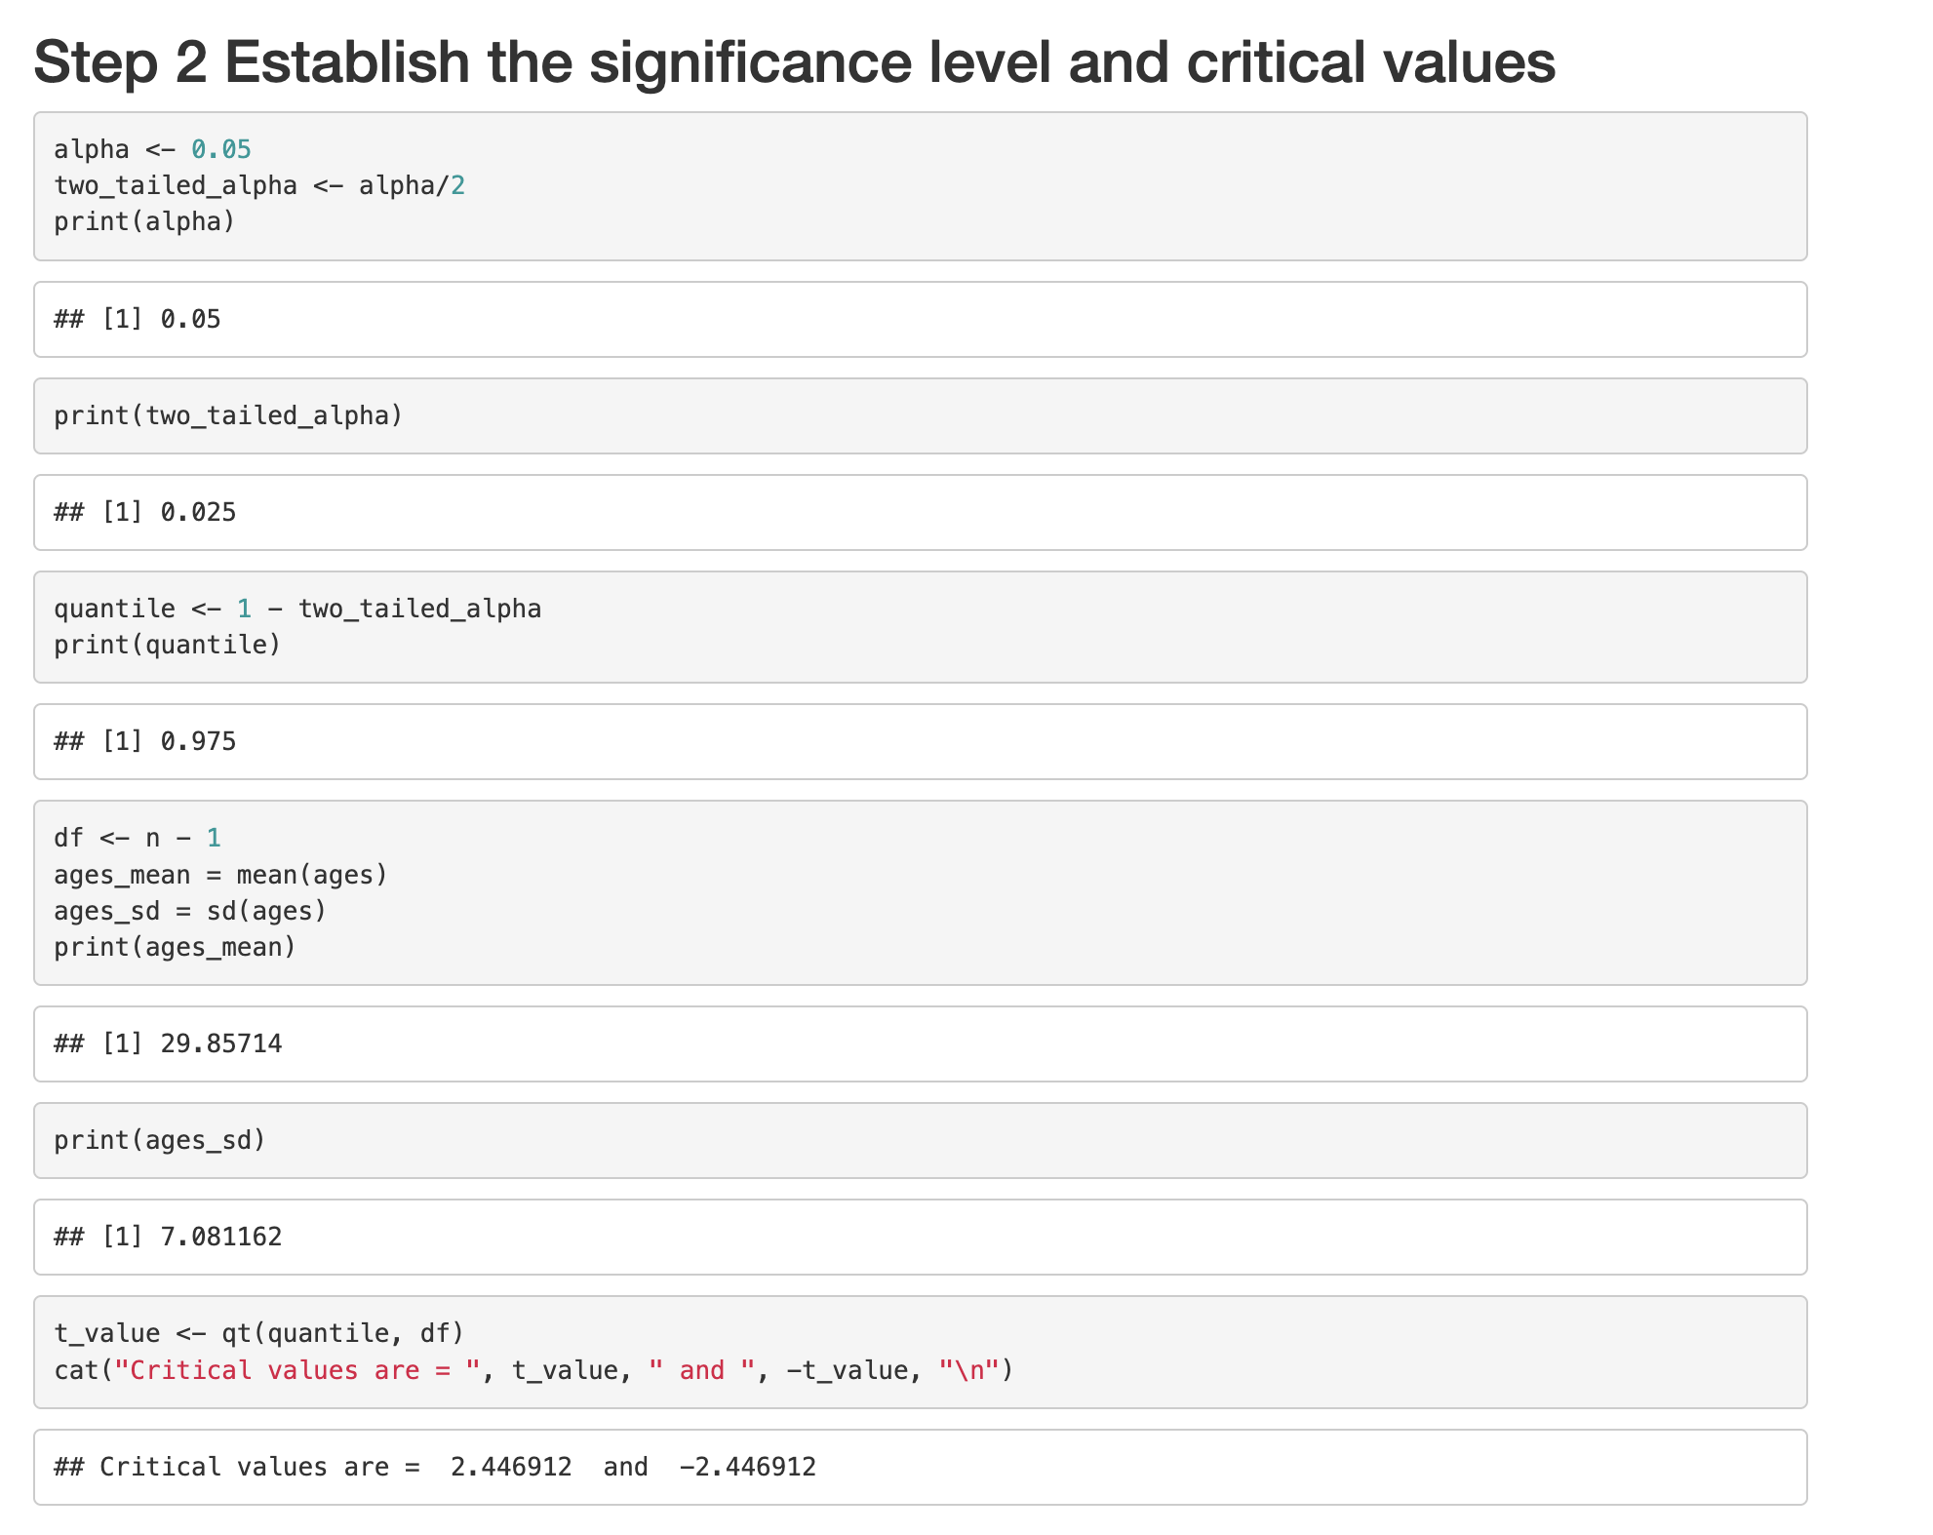
4 Hypothesis Test
6 step hypothesis t-test. H_o = 21. H_a != 21. This creates a two-tailed test.

Slide 15
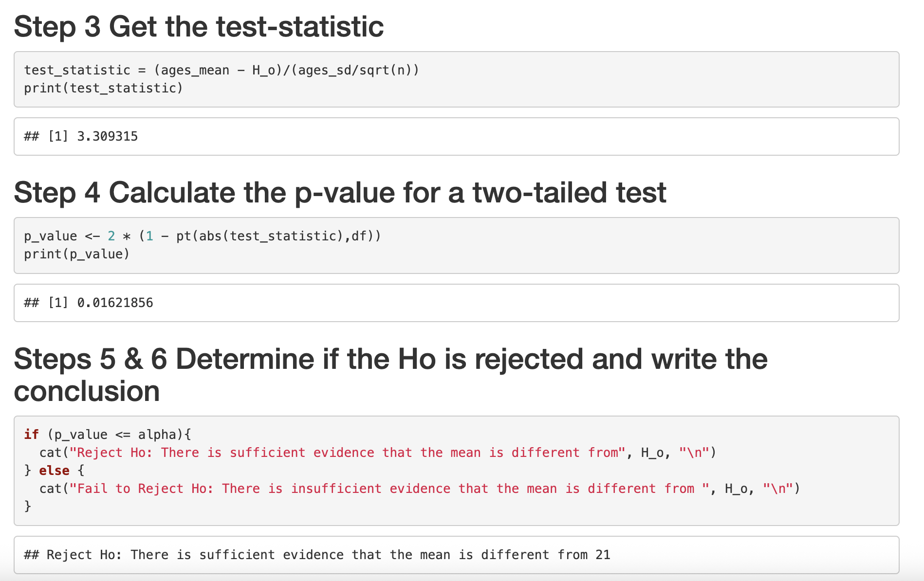
4 Hypothesis Test
6 step hypothesis t-test. H_o = 21. H_a != 21. This creates a two-tailed test.

Slide 16
5 Key takeaways
Central Limit Theorem:
Did quite a bit of research to understand the value of using the central limit theorem to understand trends in data.
Lots of value in being able to have a smaller set of data to work with.
I understand the use of rchisq() for right skewed data. Is there ever a case where the CLT would have a left skewed model? I read that the df cannot be negative so don’t understand how that would work or if it would even have value.
Hypothesis Testing:
1. This one gave me a great chance to go back and use the materials in the bridge course to conduct a two-tailed test.

